Slide 1
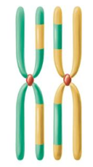
Fun with autosomal DNA? by
Julian Land
Tackling genealogical uncertainty with autosomal DNA matching
Source: www.barrow-lousada.org

Slide 2
Fun with autosomal DNA – am I crazy?
Some autosomal users will not look at matches less than 150cM – enough to find 3rd cousins
Few service providers will show autosomal matches under 7cM
But I am dealing with 10th cousins
  11 generations = 1/2000 approx.
  Divides ancestral DNA into segments averaging 2cM which produces small matches
Many problems with small matches
  High risk of false positives
  GEDmatch the only service provider at 3cM
  It changes small-match methodology often

Slide 3
Why not Y-DNA?
Y DNA results can be great as shown by Adam Brown, Michael Waas et al
3 specific results so far for me:
  Allan and Jeremy Lousada have a Y match – within the F haplogroup
  Bob Leuzarder (my Lousada 10th cousin once removed)
    is not a male-line Lousada despite his surname
    is a Y match for the Mid-West Lousadas
  Edmund Barrow (my Barrow 4th cousin) has original Ashkenasi Y
But male-lines are not easy to find – in one study I am borrowing a cousin’s DNA

Slide 4
What puzzle am I trying to solve?
  Our genealogical work covers Portugal, Spain, Italy/Tunis, France, Netherlands, Barbados, Curacao, Surinam, Jamaica, England, and New England.
  It does not prove that the various branches of the Baruch Lousada family have the same origin as there are no proven links to the Portuguese offspring of Amador de Lousada of Vinhais b1540
  Autosomal DNA is the only option to increase certainty.

Slide 5
How did I approach the problem?
Used the DNA of 12 known and probable relatives – and a random sample
Patterns of matches between them cut through the false positive problem (idea of John Griffiths my Barrow 6th cousin once-removed)
But how? - our path was full of surprises

Slide 6
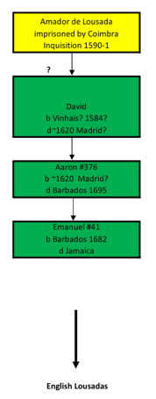
My branch of the Baruch Lousadas
We have no evidence Amador is my 9*GGF
We do not know David’s Portuguese name
Julian Land
Mike Dugdale
Jeremy Lousada
Allan Lousada
Our 1st 4 relatives for DNA

Slide 7
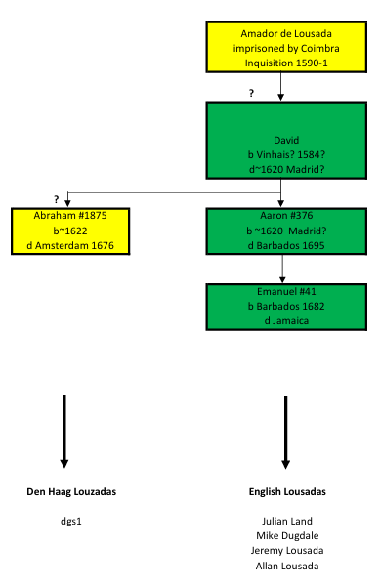
The Den Haag Louzadas
Den Haag Louzadas descend from Abraham #1875
Of Amsterdam entourage of Isaac and Abraham Israel Pereira
Like his brother Aaron #376, he was a stepson of Isaac #42 due to early death of David #1584
Bob Leuzarder reports a match with dgs1 a Querido/Louzada descendant – our only known connection with the Den Haag Louzadas

Slide 8
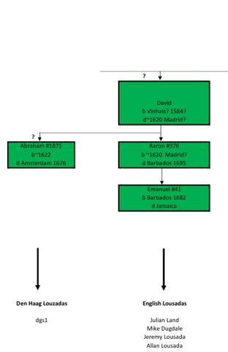
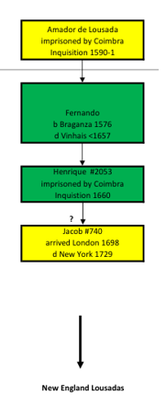
The New England Lousadas
Suggested son of Henrique
Jacob and his brother Abraham left Iberia at the time
the Falmouth packet boats left from Corunna in Spain
Bob Leuzarder
Jeannine Wegmueller
T Phelan
Bob matches Jeannine (a Luzarder)
And T Phelan (a Papacin-Louzada)
Our next 3 relatives for DNA

Slide 9
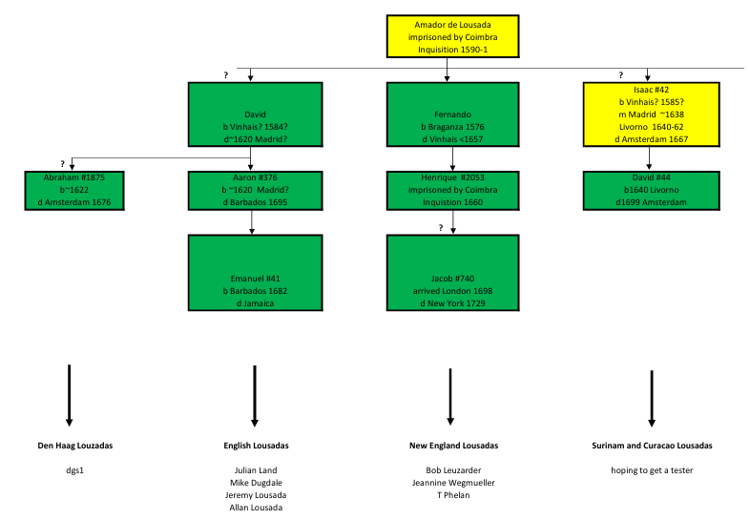
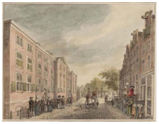
The Curacao and Surinam Baruch Louzadas
Subject of a previous talk
4 Jan 2021

Slide 10
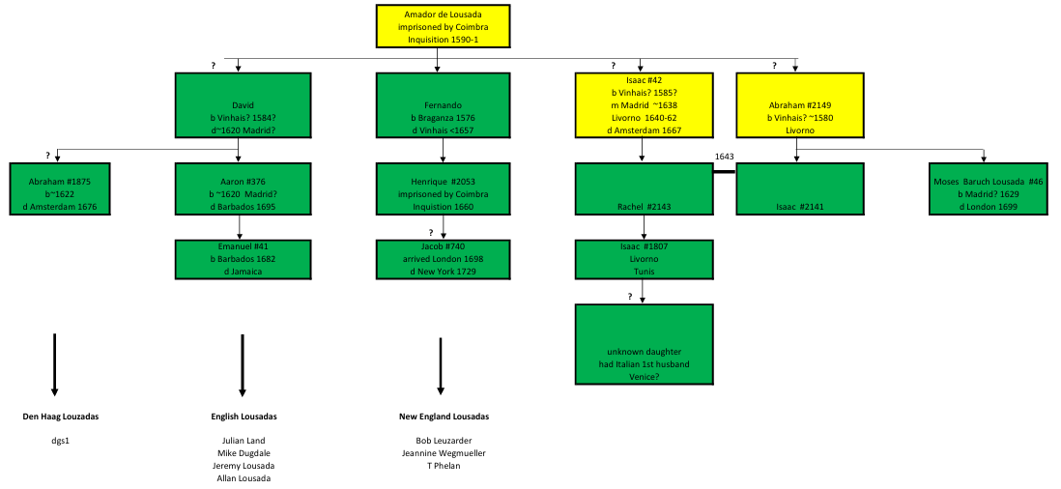
Livorno – another ancestral brother?
The well-known Moses Baruch Lousada of London Is probable son of Abraham #2149
Isaac #1807 has his father’s name
This joint great-granddaughter is a key ancestor in what follows

Slide 11
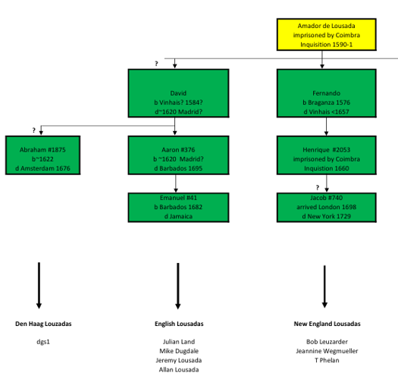
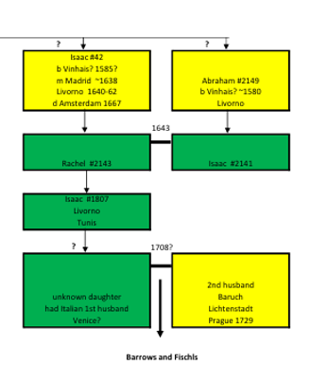
Origin of the Barrows and Fischls
We do not know the name of Baruch’s wife or her first husband
We don’t know how she got to Prague
and suggest she was widowed there
John Griffiths
Ed Barrow
Scott’s wife (from 1st husband)
3 more relatives for DNA

Slide 12
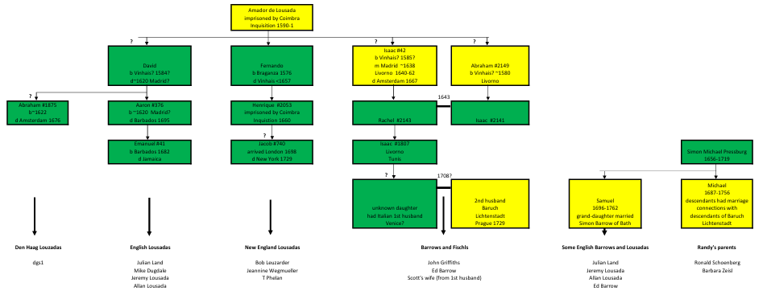
Pressburg connection
Our final 2 relatives

Slide 13
Our research project
Each of the 3 stages
used GEDmatch set at 3cM
but each used a different GEDmatch methodology for deciding what was a match
  The change from stage 1 to stage 2 was made unwittingly!
  The change from stage 2 to using Qmatch in stage 3 was made on GEDmatch advice

Slide 14
Stage 1
in 2022
6 relatives
  Julian
  Mike Dugdale
  Jeannine Wegmueller
  John Griffiths
  Ed Barrow and
  Scott’s wife

Slide 15
Stage 2
in 2024
with GEDmatch technology much better at picking up matches between relatives than between random people
7 relatives
Bob added

Slide 16
Stage 3
in 2025
12 relatives
  Allan and Jeremy Lousada (known relatives) added
  T Phelan added (probable relative – new match discovered by Bob)
  Randy’s parents added (they showed the 3 Lousada indicator locations arising from Stages 1 & 2)

Slide 17
Stage 1 outcomes
14 interesting multiple matches were identified
Set out in next slide
2 of the matches were outstanding – the rest were similar to matches between random people
We also found a very unusual phenomenon
A coincident boundary involving 4 individuals

Slide 18
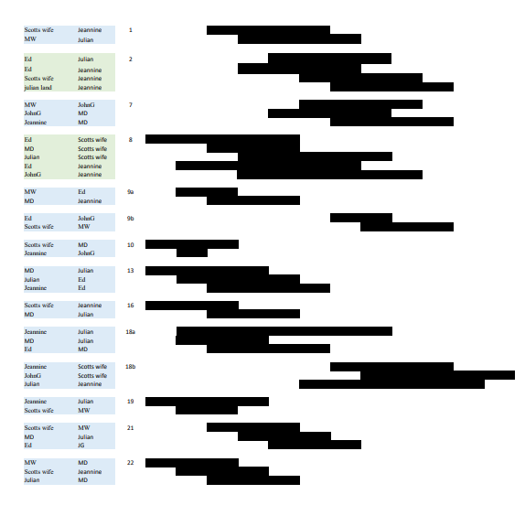
14 interesting multiple matches
Common segment boundary coincidence
Rare segment boundary coincidence

Slide 19
The 2 outstanding Lousada matches in Stage1
Chromosome 2
  4 people in this match, bridging 4 family branches
  3-way triplet intersects a 3 to 1 match
Chromosome 8
  This match represents all 6 of the relatives
  Includes a coincident segment boundary at 52269392
  The odds against such a coincidence are lower than 7000 to 1
  The other coincident boundary match is not rare – 2 to 1 against

Slide 20
Recombinations define segment boundaries
Compare 2 strands on left, and work up or down from the centromere, to see how a segment boundary is caused
Where a boundary from elsewhere coincides, the 7000 to 1 odds imply the same ancestral parents

Slide 21
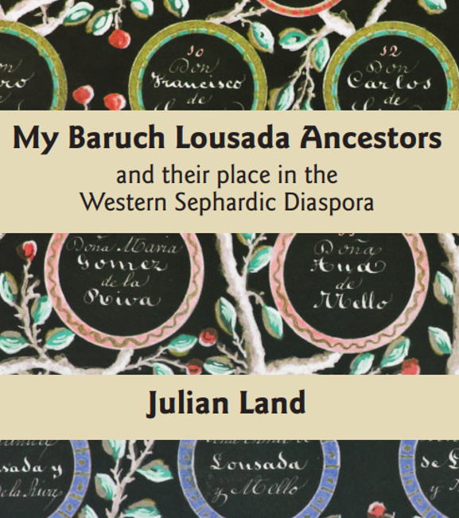
That is
Julian and/or Scott’s wife, share ancestral parents with John Griffiths and/or Jeannine Wegmueller
This result seemed important and I reported it in my coffee-table book
But ‘one swallow does not a summer make’
And it took
  2 years to find more coincidences like it
  another year to find coincidences even more dramatic
  and a month to solve the problem!

Slide 22
Stage 2 outcomes
Cr2 and Cr8 common segments each acquired more overlapping matches
An additional multiple overlap on Cr21 was identified
The rare coincident segment boundary on Cr8 survived
The 3 multiple matches – indicators of shared DNA?

Slide 23
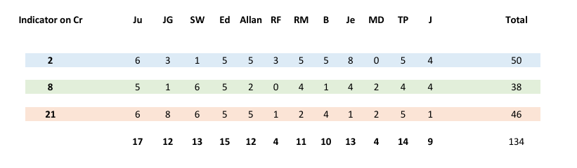
Appearances in the 3 multiple matches
with autosomal, matches disappear each generation
each person appears less than 33 times – just 11.2 average
gives us a measure we need - only 34% of this ancestral DNA is shared
and, due to consanguinity
  Julian (with Allan) is boosted by 5.5 but MD not at all
  on average, ancestral DNA is boosted by 2.4 times

Slide 24
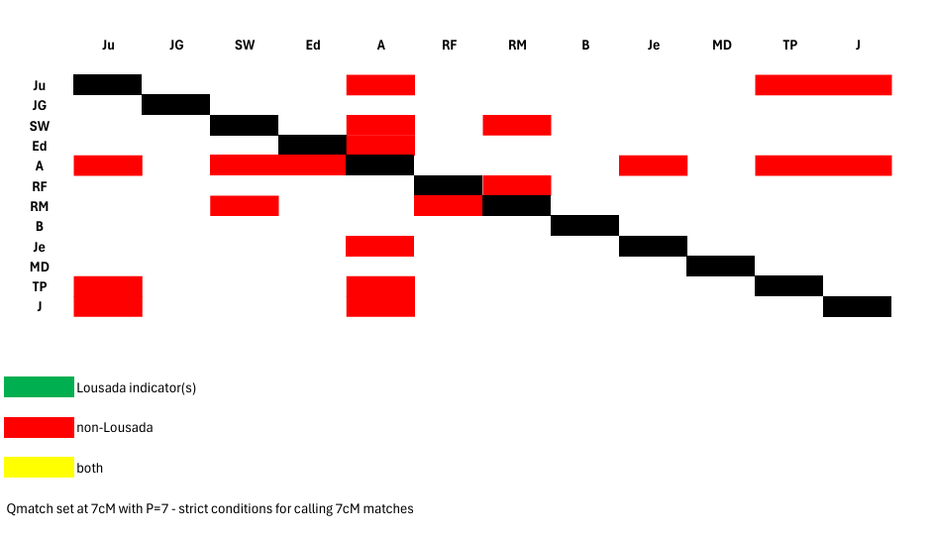
How our shared ancestry appears
- first with commercial matches
Without Allan and TP we had nothing – and little with them!

Slide 25
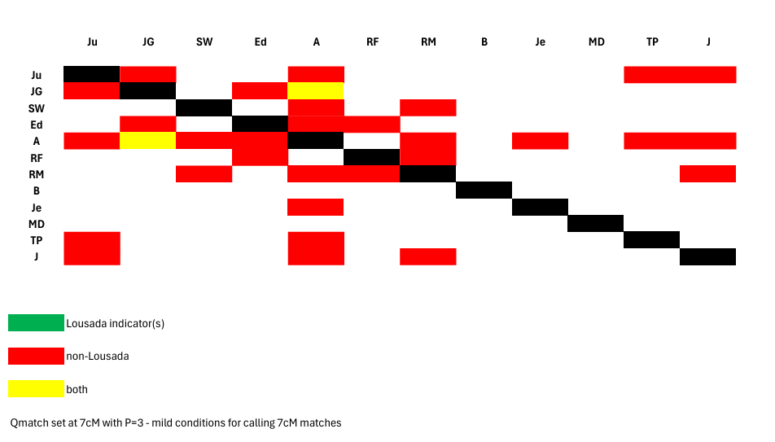
Relaxing the match criteria – still not much help
A 7cM Lousada Cr2 indicator match shows up – an outlier

Slide 26
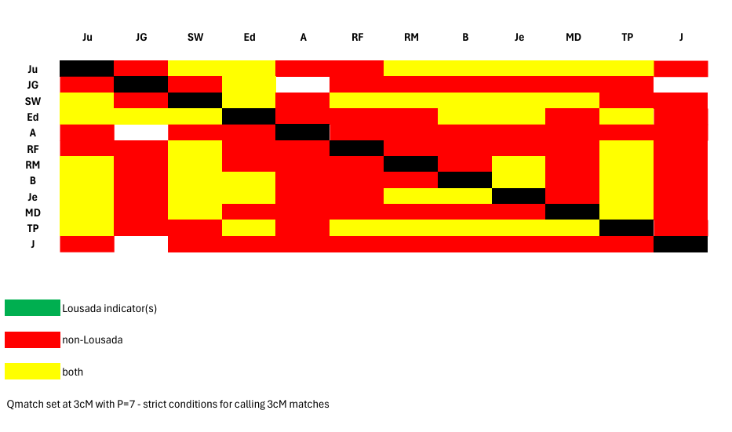
Qmatch at 3cm gives a lot more
High quality small matches – Lousada indicators now quite evident though JG/Allan match disappears!

Slide 27
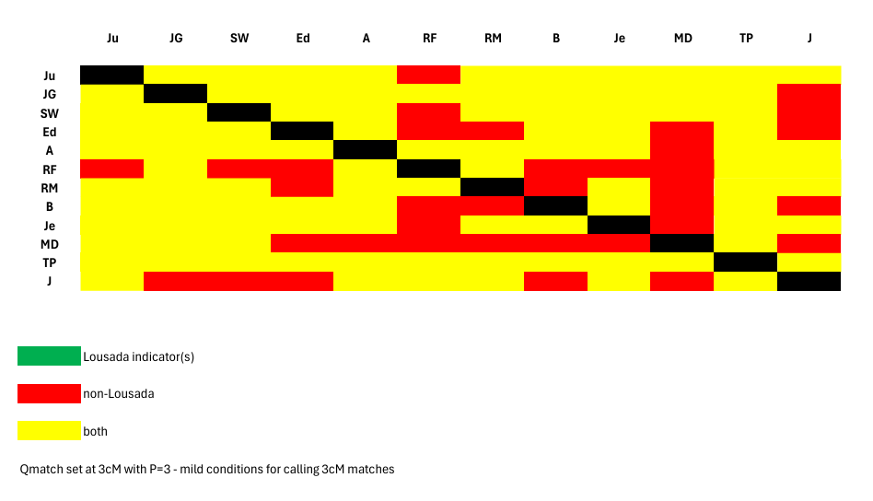
3 cM – relaxing the match criteria
Plenty of matches but no green
The 3 indicators found in Stages 1 & 2 also suit the 5 extra Stage 3 relatives.

Slide 28
Stage 3 outcomes
7 more rare coincident segment boundaries discovered
3 on Cr2, 2 more on Cr8 and 2 on Cr21
Each rare coincident boundary shows a specific genetic event
  linking up to 4 relatives and
  an ancestral family

Slide 29
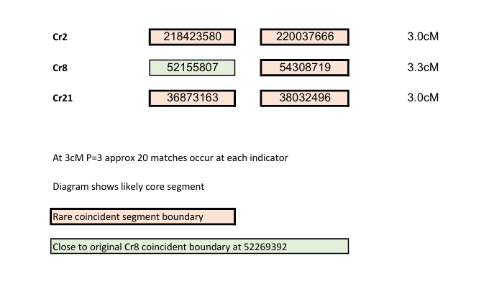
Defining our 3 ‘indicators’
Start/finish locations are based on relevant rare coincidences
Giving us shared ancestral DNA of 9.5cM

Slide 30
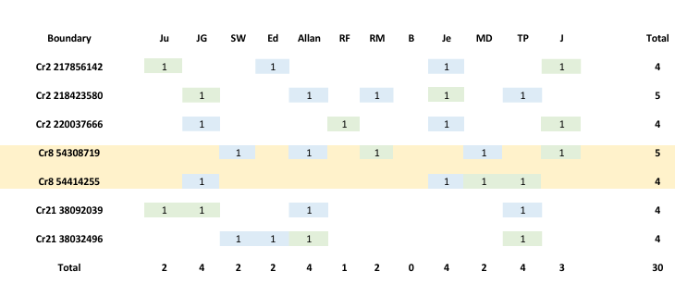
Appearances at the rare coincident segment boundaries
This dataset (sadly) mainly confirms genealogy within branches eg Je/TP
Next slide we look at ancestral family vintage

Slide 31
Vintage
Relatives in different branches are no closer than 10th cousin
Estimating shared DNA for 10th cousins
  3rd party modelling at 3cM shows average 8th cousin shared DNA is18.7cM
  We infer from this that average 10th cousin shared DNA is about 1.2cM
  Our consanguinity enhances this 2.4 times to 2.9cM
What did we find?
  Our 3 indicators total 9.5cM
  34% shared makes this 3.2cM
Thus 10th cousin appears to be the correct vintage
  11 generations ago

Slide 32
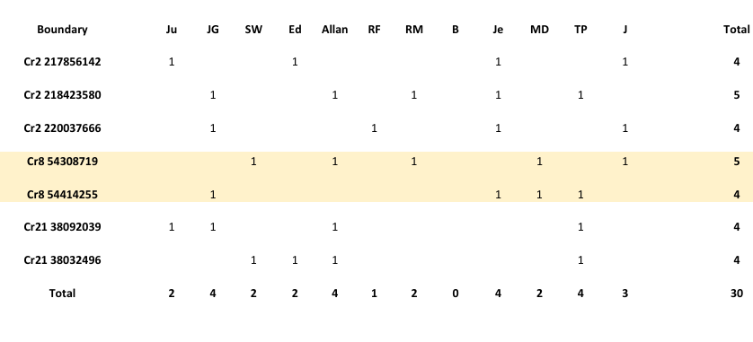
The interconnections give us
All descend from the same ancestral family
Bob’s absence rectified later!

Slide 33
Why the sequel to our research?
We have found shared DNA
But our rare coincident segment boundaries aren’t telling us enough

Slide 34
Fortune favours the prepared mind!
Another type of rare coincident segment boundary was found by accident on Cr2
  Not at the Cr2 Lousada segment
  Not even at an overlapping segment!
  Equally unlikely but much more striking
  In 3 weeks, we got further than in last 3 years

Slide 35
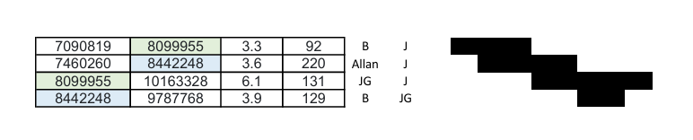
New segment boundaries
- disjoint contiguous segment boundaries
At 8099955
From 2 abutting mismatches
At 8442248

Slide 36
Abutting mismatches arise from complementary gametes
Compare 2 centre strands
Siblings can have opposite parental DNA at a recombination
While still matching a parent

Slide 37
Interpretation of the new discovery
8099955 shows B and JG descending from a pair of ancestral siblings
With Jeremy matching one of the ancestral parents
Our first proven inter-branch connection going back more than 10 generations
8442248 adds little but confirms Jeremy (and Allan) descend from the same ancestral parents

Slide 38
Conclusion A
Latest work proves that the New England Lousadas and the Barrows descend from the same ancestral family

Slide 39
Conclusion B
This was almost certainly the English Lousada ancestral family:
  For which our proof is Bob’s Den Haag Louzada match
The Barrow origin from the Baruch Lousadas is confirmed:
  Meaning Baruch Lousada DNA reached Prague around 1708

Slide 40
Conclusion C
Inter-branch connections mean the family of Amador de Lousada of Vinhais is now a more probable source:
  11 generations ago
  More than enough sons (5)

Slide 41
Conclusion D
Improbable segment boundaries may provide a basis for AI searching for remote families because
  Finding rare coincident segment boundaries is not easy
    no need to elaborately assess overlapping matches as we did!
  Interpreting them is also not easy
    a quantitative probability approach might be useful to correctly date ancestral families
  I will aim to work with GEDmatch (or FamilyTreeDNA) to develop a new service

Slide 42
Acknowledgements:
John Griffiths, my data analyst 6th cousin (once-removed) for inspiring me to tackle autosomal DNA
Randy Schoenberg for all the relatives he put onto GEDmatch and for the identity of the Prague father of Simon Barrow of Barbados
Adam Brown and Michael Waas for Y advice
Jarrett Ross for advice on my Sephardic and Ashkenasi connections
My relatives who were brave enough to offer their DNA to my studies
To Bob Leuzarder for his diligent genealogy
To all those who overcame reluctance to share ancestral information
To Ton and David for this forum and much besides

